Slide 1
Task Risk Assessment

Slide 2
ICE BREAK

Slide 3
The TRA process
Risk assessment is a structured process whereby hazards present in a workplace
are identified, evaluated
and corrective action(s) prioritized
in order to reduce risks to acceptable levels.

Slide 4
SO THAT...
REWORD
WE CAN CONTINUALLY
IMPROVE OUR SAFETY STANDARDS
AND OUR JOURNEY
TO A ZERO INURY RATE
CAN BE REALIZED and SUSTAINED

Slide 5
The TRA Process
Benefits & Strengths:
Elimination of the most significant hazards
Fulfill Regulatory & Policy requirements
Involves teams from all levels
Is focused on the actual work activity
Improved awareness of hazards and/ or identify new ones.
Ensure the correct “control measures” are in place and reflected in job procedures,
Continuously improve Safety systems and conditions of work
Reduce incidents

Slide 6
When it should be used
When….
Proper safety procedures are identified as not being in place
Existing procedures are not adequate
New job, task, chemical, machine has been introduced
Existing task has been significantly changed
New/ different people doing the task
Specific Regulatory or Company requirement
Change in standards
Changes in technology
Unplanned work
To continue work after an incident or injury has occurred
Result of medical surveillance

Slide 7
When do you apply?
EXAMPLES:
Electrical Work
D&R Work
High pressure cleaning
Confined space Entry
Line Break
Working at heights
Deviations from SHE procedures and SOP’s
Rigging & Hoisting
Hot Work (flames / sparks)
New tasks/jobs
Details job not known
Dangerous chemicals involved
Other jobs in same area
Contractor work
Jobs with > 1 person
non barricaded area
not familiar with the job ?

Slide 8
When is it NOT required?
For tasks where the hazards/risks
are obvious
and well known
and clearly understood.
Typically this is the case for jobs
for which we have SOP’s.

Slide 9
TRA Procedure/ Training Overview
TRA technique is to be applied for General Safety,,,,
not intended to be used to classify hazards or risks associated with
Process Safety Management.

Slide 10
TRA TRAINING PACKAGE
1. Reasons, study purposes
2. Hazard & Risk
3. Hazard Categories
4. Existing safety measures and strategy processes
5. Walk-through form
6. Checklist

Slide 11
Training Covers the:
Purpose?
Who?
What?
Where?
When?
How?
Examples
Exercise

Slide 12
Guidelines of Training Workshop:
Successfully Delivered In a way that :
Priority can be given to the execution of a TRA.
One knows when a TRA should be applied.
One is capable of :
doing a TRA
documenting a TRA
preparing a plan of action
discussing
One can decide who is needed for the TRA.

Slide 13
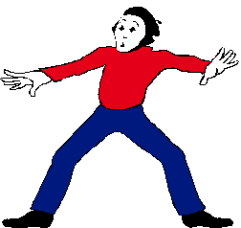
You don’t need to study for this!
You don’t need
to be a scientist or a professor
to do this!
Assessing risks is something
people do naturally but
you do need to gain experience

Slide 14
What constitutes a TRA?
- Dividing of jobs into sub-tasks
- Identifying hazards
- Evaluate the risk
- Implement measures that will eliminate or minimize risks
- Take action on important findings
These need to be brought back to acceptable levels

Slide 15
Hazard & Risk

Slide 16
DEFINITIONS
Hazard
……something that can cause injury or damage to ones health.
Risk
the likelihood that an injury will occur

Slide 17
EXAMPLE OF HAZARDS & RISKS
Activity: CROSSING A BUSY ROAD
Hazard = Being hit by a car
Risk = Actual chance of being hit and injured
Frequency of Exposure :
- do you do it every year, month, day, every hour?
Severity:
possible serious or fatal injury
Probability:
- the practical chance that it will happen

Slide 18
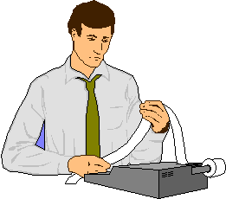
Calculation Method
RISK = Exposure x Severity x Probability

Slide 19
HAZARD CATEGORIES
PHYSICAL
CHEMICAL
ERGONOMIC
BIOLOGICAL
ENVIRONMENTAL

Slide 20
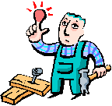
PHYSICAL HAZARDS
ELECTRICAL,
RADIATION,
SOUND, VIBRATION,
MECHANICAL/MACHINES,
FALLING (OBJECTS & PEOPLE)
FIRE

Slide 21
CHEMICAL HAZARDS
LIQUIDS, GASSES, SOLIDS
Enter the body by means of :
SWALLOWING (mouth)
ABSORBTION (skin)
INHALING (airways)

Slide 22
CHEMICAL HAZARDS :
EXPLOSIVE
OXIDATION
FLAMMABLE
POISONOUS
CHEMICAL BURNING
IRRITATION
SENSITIVITY
CANCER CAUSING
MUTATION
REPRODUCTIVE

Slide 23
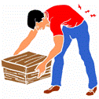
ERGONOMIC HAZARD
BACK INJURY
HAND, WRIST, ARM, NECK STRESS AS A RESULT OF COMPUTER USE
UNCOMFORTABLE POSITIONS WHICH CAUSE STRESS TO THE MUSCLES
INJURY DUE TO OVER EXERSION
MUSCLE TEARING

Slide 24
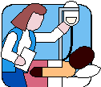
BIOLOGICAL HAZARDS
HEPATITIS,
HIV-INFECTED
LEGIONNAIRES DISEASE
This is a highly specialized area where health care professionals should be consulted

Slide 25
ENVIRONMENTAL HAZARDS
- EMISSIONS
- SPILLS
- PRODUCTS THAT POLLUTE
THE EARTH
- GROUND WATER
- WASTE IN GENERAL

Slide 26
EVALUATING PROTECTION via EXISTING SAFETY MEASURES

Slide 27
Existing Safety Measures
Safety rules, procedures & manuals
Operating procedures
Permit systems
(LTCT, confirmed space, hotwork etc)
Monitoring & sampling
Auditing
Training/information/instruction
Supervision
Emergency Plans
Personal protective equipment (PPE)

Slide 28
Action Plans are needed if:
There is insufficient control on the basis
of the hazard with existing safety measures.

Slide 29
TRA - Task Risk Assessment
This is a methodology to identify and evaluate the hazards and risks in a systematic and quantitative way.
The system used is often referred to as “Kinney and Fine”, two European researchers.

Slide 30
BASIC TRA STEPS:
Identify task and sub-tasks
Identify Hazard
Calculate initial Risk-Score
Include standard and additional measures. Always take prevention hierarchy into account (see next slide)
Define measure(s)
N
Calculate Actual-Risk
Acceptable ?
Implement measure(s)
File Risk Analysis

Slide 31
Prevention Hierarchy for control measures
1. Elimination: Eliminate Risk
2. Substitution: Reduce Risk at source
or remove source
3. Engineering Control: Take collective measures
4. Administrative Control: Training + procedures
+ instructions
5. PPE: Make people wear PPE

Slide 32
Risk Score with Kinney & Fine
RISK = Exposure x Severity x Probability
R = E X S X P

Slide 33
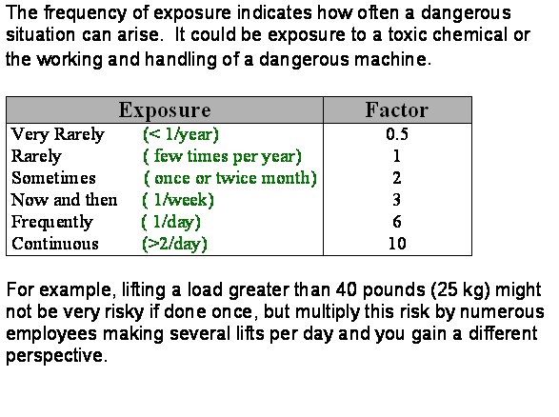
Exposure:

Slide 34
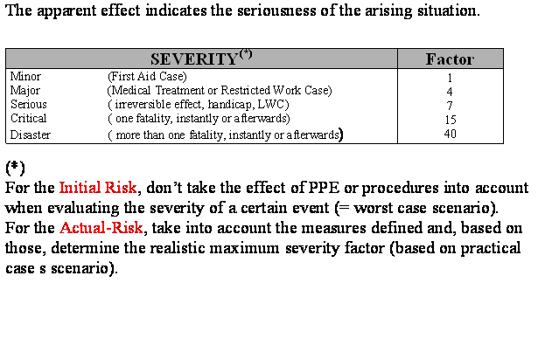
Severity:

Slide 35
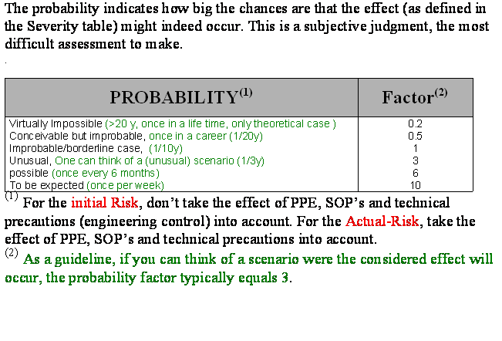
Probability:

Slide 36
Risk Score Interpretation:

Slide 37
Walk-through form & Checklist
Walk through
TRA checklist

Slide 38
Pit-falls
Always do it in group.
Group results are more stable than results of individuals.
If R<20, we still can decide to take measures based on common sense.
e.g; Low Frequency x High Severity x Low Probability
Not re-calculating score after corrective actions have been developed
Undertaking a risk assessment to try to justify a decision that already has been taken.
Undertaking a detailed quantified risk assessment without considering if relevant good practice was available
Not identifying all hazards associated with the activities
Failure to fully & truly consider all potential outcomes
Not linking hazards with risk controls.
Not being familiar with the situation in the field

Slide 39
Questions ?

Slide 40
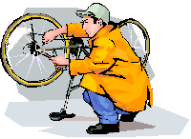
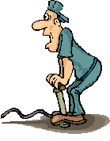
Exercise 1: fix the tires of your bike
Individually: list all the subtasks you see relative to the job

Slide 41
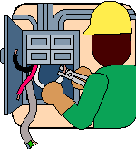
Example 1: Electrical cabinet
Evaluate need for measures for electrical work in an MCC. The Risk is getting burned by electrical arc.
Initial Risk
E = 1
S = 15
P = 3
R = 45
Measures
full PPE
procedures
Actual Risk 1
E = 1
S = 7
P = 5
R = 35
Additional Measures (since R>20)
Trained standby-man for immediate alarm and isolation of victim to minimise potential injury + current limiting fuse.
Actual Risk 2
E = 1 S = 4 P = 3
R = 12 (acceptable situation)

Slide 42
Exercise 2: Cut straps on bags
Try to evaluate with what kind of knife the bags must be cut open and how ...

Slide 43
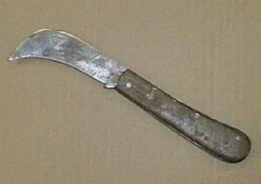
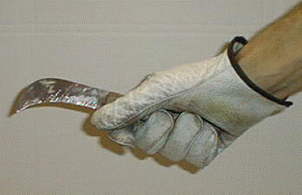
The knives

Slide 44
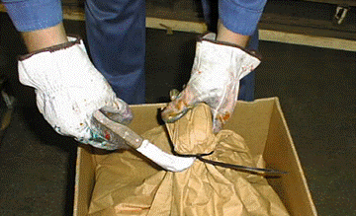
Risk is to cut fingers/hand/bodyparts
Evaluation: If one uses the knive with wooden handle and leather gloves, what is the risk to cut yourself and how would you improve the situation

Slide 45
Initial Risk
Initial Risk
E = 7
S = 7
P = 6
R = 294
Measures 1
Kevlar® gloves
Safety knife with spring loaded retractable blade
Procedure: Cut away from body

Slide 46
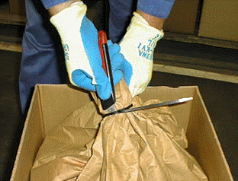
New Situation
Actual Risk 1
E = 7
S = 3
P = 3
R = 63
Measures 2
Kevlar® gloves
Side Cutter

Slide 47
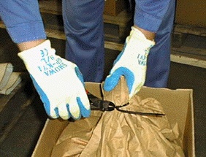
End Result
Actual Risk 2
E = 7
S = 1
P = 2.5
R = 17.5
R < 20 AND S < 4 ……… This is an acceptable situation

Slide 48
For the safe world,
work together for the one world.

